Slide 1

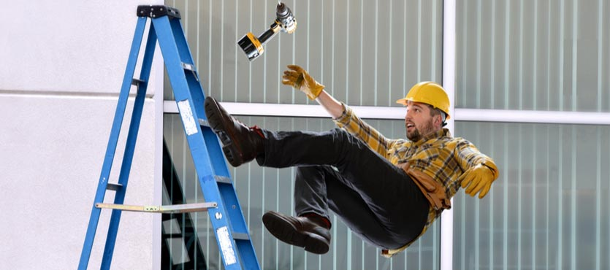
Workers Compensation System Health Insurance

Slide 2


Slide 3

Personal Information
Worker Status Details
Injury Information
Others

Slide 4
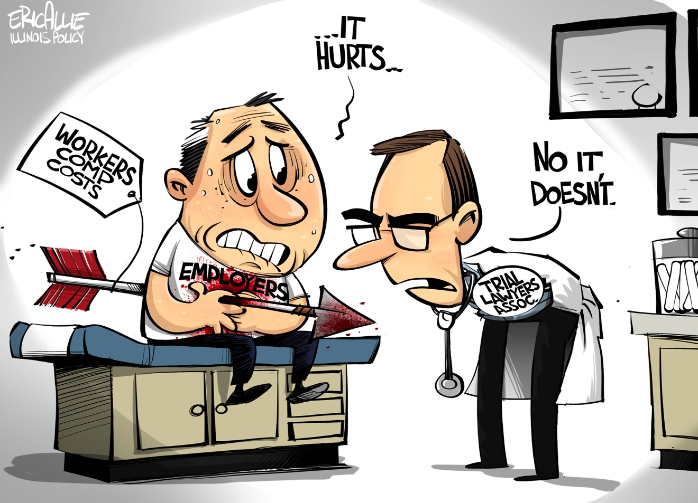

Slide 5
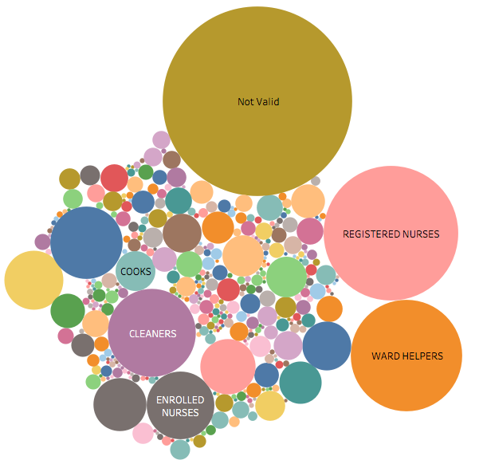
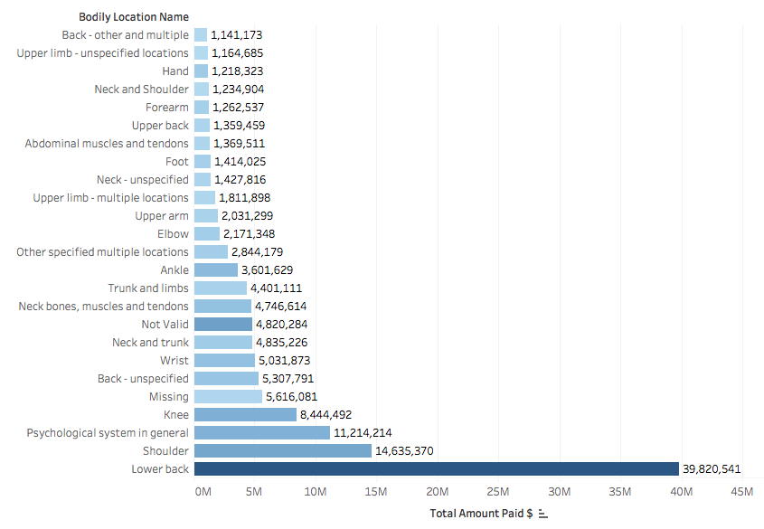
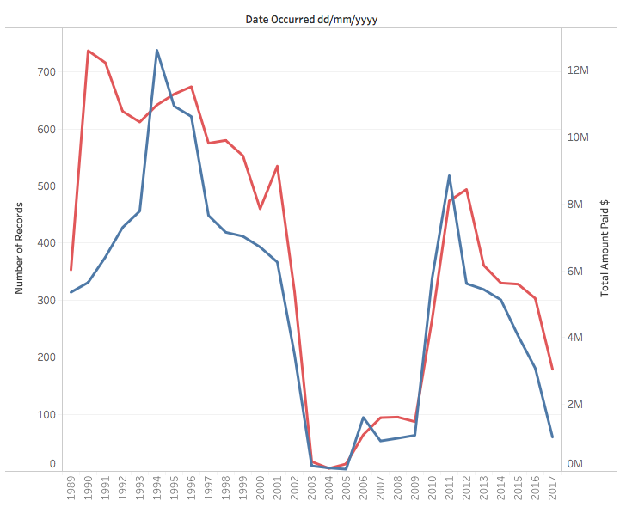
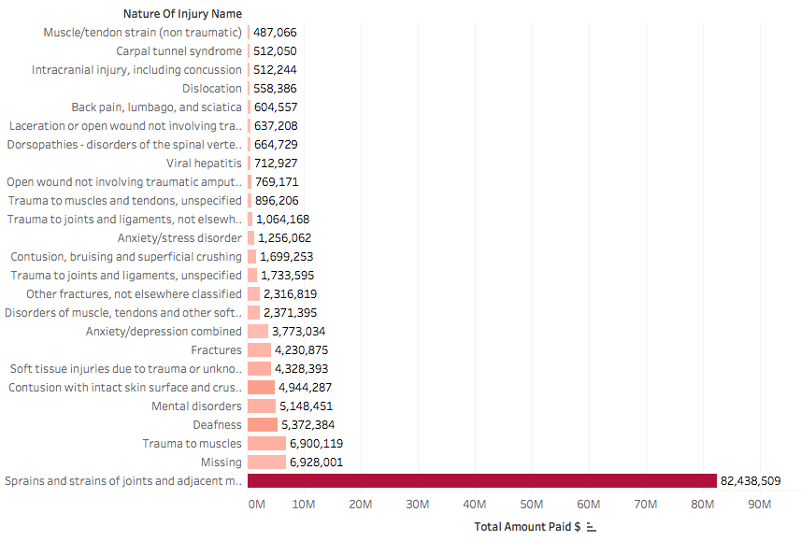

Slide 6
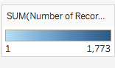

Slide 7
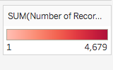

Slide 9
MOST COMMON INJURIES?
Fall Level
Vehicle Accident
Stress Lifting Carrying
Carrying Object
Muscular Stress
Lifting Carrying Object
Muscular Stress
Lifting

Slide 10



Main Factors for High Injury Cost
Cost Legal
Hours Paid Total Incapacity
Occupation Rehabilitation Treatment
Hourly Salary Rate
Work Status Name
Working for the Same employer
full work capacity

Slide 11
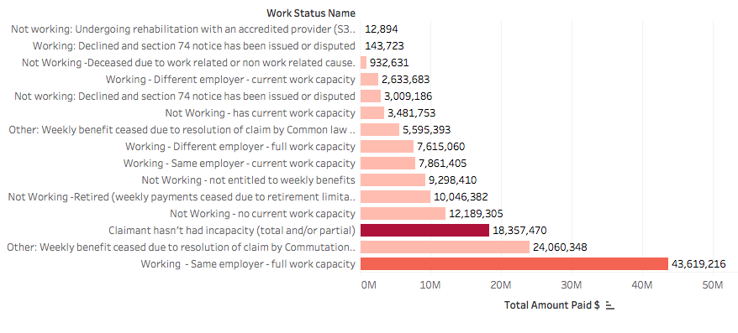
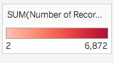

Slide 12
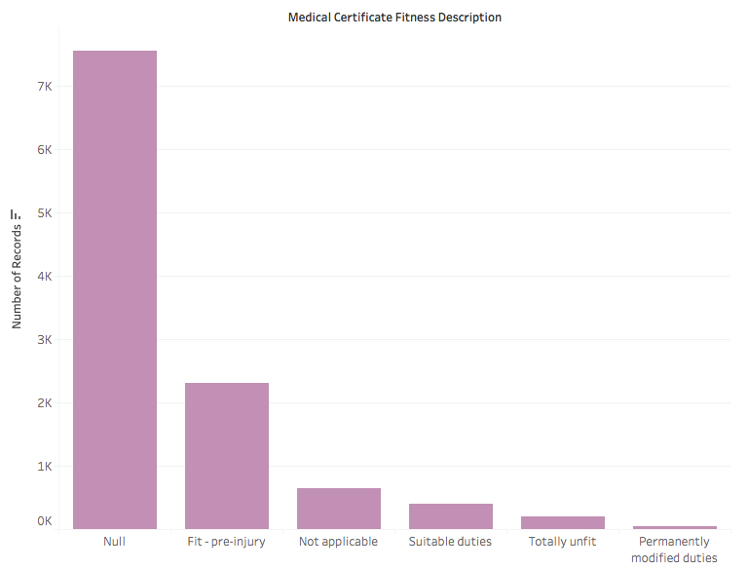

Slide 13

Any Questions?

